Slide 1
Cryptography and Network Security
X.509 Certificate

Slide 2
Session Meta Data
Author | Dr T Sree Sharmila
Reviewer
Version Number | 1.0
Release Date | 1 August 2018

Slide 3
Revision History
Revision Date | Details | Version no.
 |  | 1.0

Slide 4
Agenda
X.509 authentication service
X.509 certificates
Obtaining a certificate
CA hierarchy
Certificate revocation
Authentication procedures
Public Key infrastructure
X.509 version3
Certificate extension
Summary
Test your understanding
References

Slide 5
X.509 Authentication Service
part of CCITT X.500 directory service standards
distributed servers maintaining some info database
defines framework for authentication services
directory may store public-key certificates
with public key of user
signed by certification authority
also defines authentication protocols
uses public-key crypto & digital signatures
algorithms not standardised, but RSA recommended
Notes:
X.509 is the Internationally accepted standard for how to construct a public key certificate, and is becoming widely used. It has gone through several versions. It is used by S/MIME secure email, SSL/TLS secure Internet links (eg for secure web).

Slide 6
Agenda
X.509 authentication service
X.509 certificates
Obtaining a certificate
CA hierarchy
Certificate revocation
Authentication procedures
Public Key infrastructure
X.509 version3
Certificate extension
Summary
Test your understanding
References

Slide 7
X.509 Certificates
issued by a Certification Authority (CA), containing:
version (1, 2, or 3)
serial number (unique within CA) identifying certificate
signature algorithm identifier
issuer X.500 name (CA)
period of validity (from - to dates)
subject X.500 name (name of owner)
subject public-key info (algorithm, parameters, key)
issuer unique identifier (v2+)
subject unique identifier (v2+)
extension fields (v3)
signature (of hash of all fields in certificate)
notation CA<<A>> denotes certificate for A signed by CA
Notes:
The X.509 certificate is the heart of the standard. There are 3 versions, with successively more info in the certificate - must be v2 if either unique identifier field exists, must be v3 if any extensions are used.

Slide 8
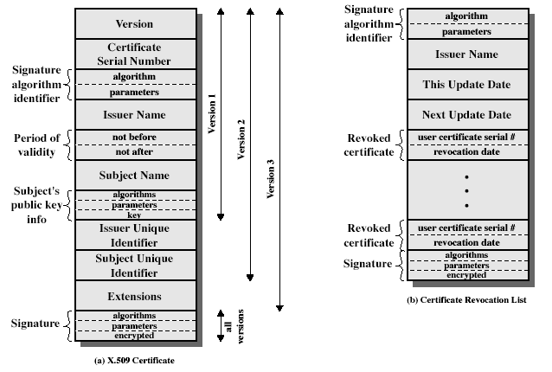
X.509 Certificates
Notes:
Stallings Fig 14.3

Slide 9
Agenda
X.509 authentication service
X.509 certificates
Obtaining a certificate
CA hierarchy
Certificate revocation
Authentication procedures
Public Key infrastructure
X.509 version3
Certificate extension
Summary
Test your understanding
References

Slide 10
Obtaining a Certificate
any user with access to CA can get any certificate from it
only the CA can modify a certificate
because cannot be forged, certificates can be placed in a public directory

Slide 11
Agenda
X.509 authentication service
X.509 certificates
Obtaining a certificate
CA hierarchy
Certificate revocation
Authentication procedures
Public Key infrastructure
X.509 version3
Certificate extension
Summary
Test your understanding
References

Slide 12
CA Hierarchy
if both users share a common CA then they are assumed to know its public key
otherwise CA's must form a hierarchy
use certificates linking members of hierarchy to validate other CA's
each CA has certificates for clients (forward) and parent (backward)
each client trusts parents certificates
enable verification of any certificate from one CA by users of all other CAs in hierarchy
Notes:
All very easy is both parties use the same CA. If not, then there has to be some means to form a chain of certifications between the CA's used by the two parties. And that raises issues about whether the CA's are equivalent, whether they used the same policies to generate their certificates, and how much you're going to trust a CA at some remove from your own. These are all open issues.

Slide 13
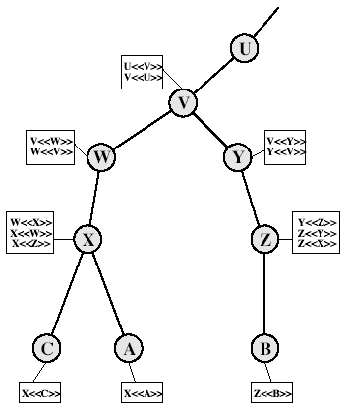
CA Hierarchy Use
Notes:
Stallings Fig 14.4.
Track chains of certificates:
A acquires B certificate using chain: X<<W>>W<<V>>V<<Y>>Y<<Z>>Z<<B>>
B acquires A certificate using chain: Z<<Y>>Y<<V>>V<<W>>W<<X>>X<<A>>

Slide 14
Agenda
X.509 authentication service
X.509 certificates
Obtaining a certificate
CA hierarchy
Certificate revocation
Authentication procedures
Public Key infrastructure
X.509 version3
Certificate extension
Summary
Test your understanding
References

Slide 15
Certificate Revocation
certificates have a period of validity
may need to revoke before expiry, eg:
user's private key is compromised
user is no longer certified by this CA
CA's certificate is compromised
CA’s maintain list of revoked certificates
the Certificate Revocation List (CRL)
users should check certs with CA’s CRL

Slide 16
Agenda
X.509 authentication service
X.509 certificates
Obtaining a certificate
CA hierarchy
Certificate revocation
Authentication procedures
Public Key infrastructure
X.509 version3
Certificate extension
Summary
Test your understanding
References

Slide 17
Authentication Procedures
X.509 includes three alternative authentication procedures:
One-Way Authentication
Two-Way Authentication
Three-Way Authentication
all use public-key signatures
Notes:
The X.509 standard specifies the authentication protocols that can be used when obtaining and using certificates. 1-way for unidirectional messages (like email), 2-way for interactive sessions when timestamps are used, 3-way for interactive sessions with no need for timestamps (and hence synchronised clocks).

Slide 18
One-Way Authentication
1 message ( A->B) used to establish
the identity of A and that message is from A
message was intended for B
integrity & originality of message
message must include timestamp, nonce, B's identity and is signed by A

Slide 19
Two-Way Authentication
2 messages (A->B, B->A) which also establishes in addition:
the identity of B and that reply is from B
that reply is intended for A
integrity & originality of reply
reply includes original nonce from A, also timestamp and nonce from B

Slide 20
Three-Way Authentication
3 messages (A->B, B->A, A->B) which enables above authentication without synchronized clocks
has reply from A back to B containing signed copy of nonce from B
means that timestamps need not be checked or relied upon

Slide 21
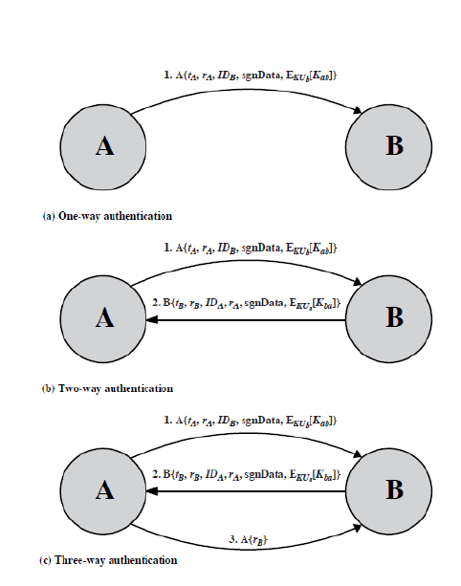

Slide 22
Agenda
X.509 authentication service
X.509 certificates
Obtaining a certificate
CA hierarchy
Certificate revocation
Authentication procedures
Public Key infrastructure
X.509 version3
Certificate extension
Summary
Test your understanding
References

Slide 23
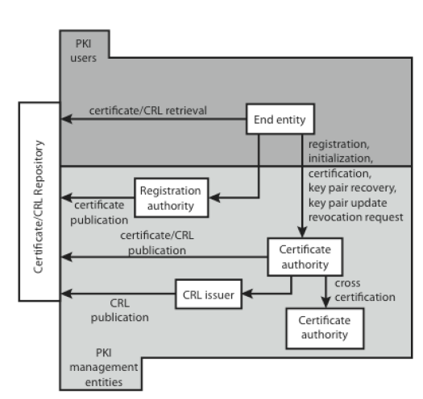
Public Key Infrastructure

Slide 24
Agenda
X.509 authentication service
X.509 certificates
Obtaining a certificate
CA hierarchy
Certificate revocation
Authentication procedures
Public Key infrastructure
X.509 version3
Certificate extension
Summary
Test your understanding
References

Slide 25
X.509 Version 3
has been recognised that additional information is needed in a certificate
email/URL, policy details, usage constraints
rather than explicitly naming new fields defined a general extension method
extensions consist of:
extension identifier
criticality indicator
extension value

Slide 26
Agenda
X.509 authentication service
X.509 certificates
Obtaining a certificate
CA hierarchy
Certificate revocation
Authentication procedures
Public Key infrastructure
X.509 version3
Certificate extension
Summary
Test your understanding
References

Slide 27
Certificate Extensions
key and policy information
convey info about subject & issuer keys, plus indicators of certificate policy
certificate subject and issuer attributes
support alternative names, in alternative formats for certificate subject and/or issuer
certificate path constraints
allow constraints on use of certificates by other CA’s

Slide 28
Agenda
X.509 authentication service
X.509 certificates
Obtaining a certificate
CA hierarchy
Certificate revocation
Authentication procedures
Public Key infrastructure
X.509 version3
Certificate extension
Summary
Test your understanding
References

Slide 29
Summary
have considered:
X.509 authentication and certificates

Slide 30
Agenda
X.509 authentication service
X.509 certificates
Obtaining a certificate
CA hierarchy
Certificate revocation
Authentication procedures
Public Key infrastructure
X.509 version3
Certificate extension
Summary
Test your understanding
References

Slide 31
Test your understanding
What is a public key certificate?
What is the purpose of X.509 standard?
Why is it sometimes desirable to revoke an X.509 certificate before it expires?

Slide 32
Agenda
X.509 authentication service
X.509 certificates
Obtaining a certificate
CA hierarchy
Certificate revocation
Authentication procedures
Public Key infrastructure
X.509 version3
Certificate extension
Summary
Test your understanding
References

Slide 33
References
1. William Stallings, Cryptography and Network Security, 6th Edition, Pearson Education, March 2013.
2. Charlie Kaufman, Radia Perlman and Mike Speciner, “Network Security”, Prentice Hall of India, 2002.

